Slide 1
Systems Analysis and Design 11th Edition
Chapter 1
Introduction to Systems Analysis and Design

Slide 2
Chapter Objectives
Describe the impact of information technology
Define systems analysis and design and the role of a systems analyst
Define an information system and describe its components
Explain how to use business profiles and models
Explain Internet business strategies and relationships, including B2C and B2B

Slide 3
Chapter Objectives (Cont.)
Identify various types of information systems and explain who uses them
Distinguish among structured analysis, object-oriented analysis, and agile methods
Explain the waterfall model, and how it has evolved
Discuss the role of the information technology department and the systems analysts who work there

Slide 4
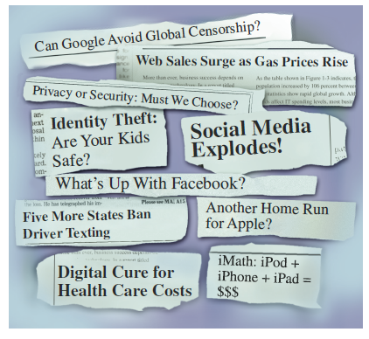
Introduction
Information helps companies:
Increase productivity
Deliver quality products and services
Maintain customer loyalty
Make sound decisions
Use of information technology is vital for organizational success
FIGURE 1-1 These headlines show the enormous impact of information technology on our lives.

Slide 5

What Is Information Technology?
Information Technology (IT)
Combination of hardware and software products and services used to manage, access, communicate, and share information
Changing Nature of Information Technology
Change is dramatic and continuous
Advances influence change in business organizations
FIGURE 1-2 An employee clocking in with a punch card in 1953.
ClassicStock.com/Superstock

Slide 6
What Is Information Technology? (Cont.)
Systems Analysis and Design
Step-by-step process for developing high-quality information systems
Information systems: Combination of technology, people, and data to perform certain business functions
What Does a Systems Analyst Do?
Plans, develops, and maintains information systems
Manages IT projects, including tasks, resources, schedules, and costs
Conducts meetings, delivers presentations, and writes memos, reports, and documentation

Slide 7
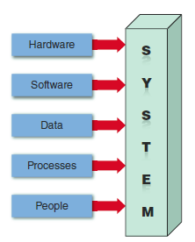
Information System Components
System: Set of related components that produces specific results
Mission-critical systems are vital to a company’s operations
All systems require input data
Data: Basic facts that serve as raw material
Information: Data transformed into output
FIGURE 1-5 An information
system needs these components.

Slide 8
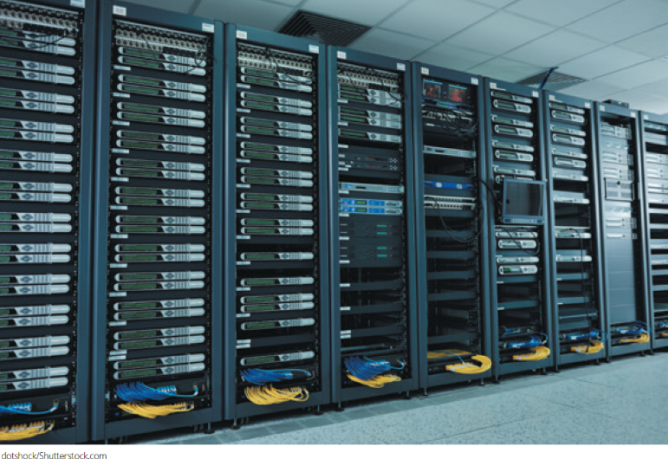
Information System Components (Cont.1)
Hardware
Physical layer of the information system
Moore’s Law was integral to the development of hardware
Software
Controls hardware
System software
Application software
Horizontal system
Vertical system
Legacy system
FIGURE 1-6 Server farms provide the enormous power and speed that modern IT systems need.
dotshock/Shutterstock.com

Slide 9
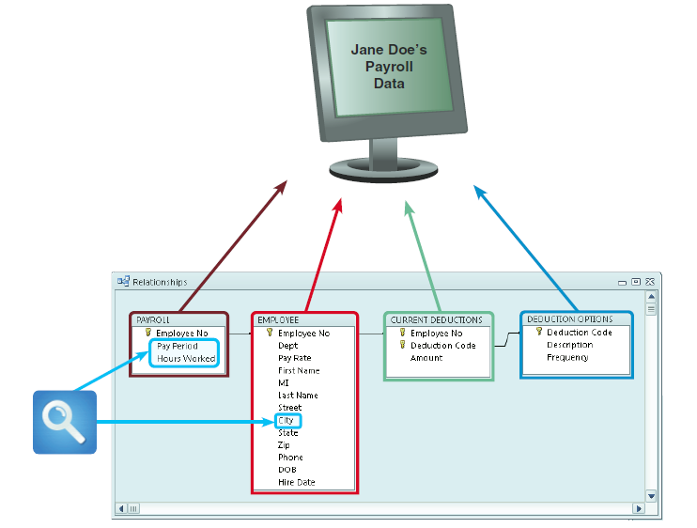
Information System Components (Cont. 2)
Data
Stored in tables
Processes
Describe the tasks and business functions performed to achieve specific results
People
Stakeholders: Individuals interested in an information system
FIGURE 1-7 In a typical payroll system, data is stored in separate tables that are linked to form an overall database.

Slide 10
Business Today
Influenced by:
Rapidly increasing globalization
Technology integration for seamless information access
Rapid growth of cloud-based computing and services
All trends are Internet-centric

Slide 11
Business Today (Cont.1)
The Internet Model
Ecommerce (electronic commerce)
User interface - Enables communication between a data-base management software and a web-based server
Mobile devices interact with the system using apps
Sectors
B2C (business-to-customer)
B2B (business-to-business)

Slide 12
Business Today (Cont.2)
B2C (Business-to-Customer)
In a single convenient session, customers can:
Do research and compare prices and features
Check availability and arrange delivery
Choose payment methods
B2B (Business-to-Business)
Ecommerce was initially carried out using electronic data interchange (EDI)
Most firms use supply chain management (SCM) software, which helps businesses manage inventory levels, costs, alternate suppliers

Slide 13
Modeling Business Operations
Business Profile
Overview of a company’s mission, functions, organization, products, services, customers, suppliers, competitors, constraints, and future direction
Business Process
Specific set of transactions, events, and results that can be described and documented
Business process model (BPM)
Business process modeling notation (BPMN)

Slide 14
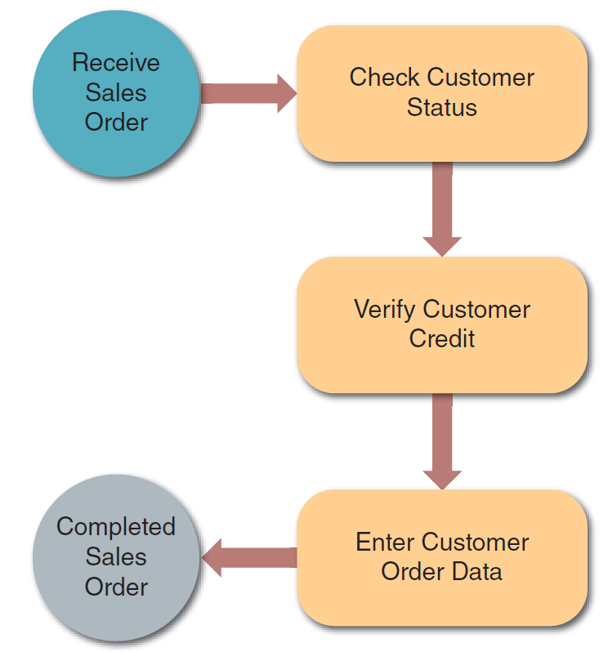
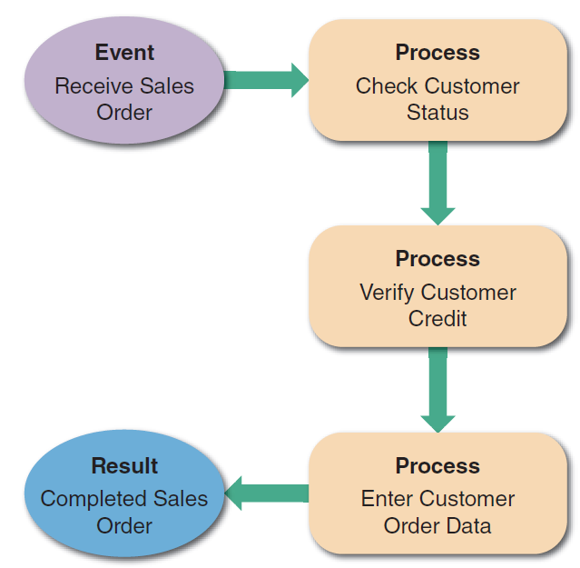
Modeling Business Operations (Cont.)
FIGURE 1-8 A simple business model might consist of an event, three processes, and a result.
FIGURE 1-9 This sample uses business process modeling notation (BPMN) to represent the same events, processes, and workflow shown in Figure 1-8.
Source: Drawio.com

Slide 15
Business Information Systems
Current Method
All employees use office productivity systems
Operations users require decision support systems
Systems are defined by their functions and features
Enterprise Computing
Supports company-wide operations and data management requirements
Enterprise resource planning (ERP) systems provide cost-effective support for users and managers throughout the company

Slide 16
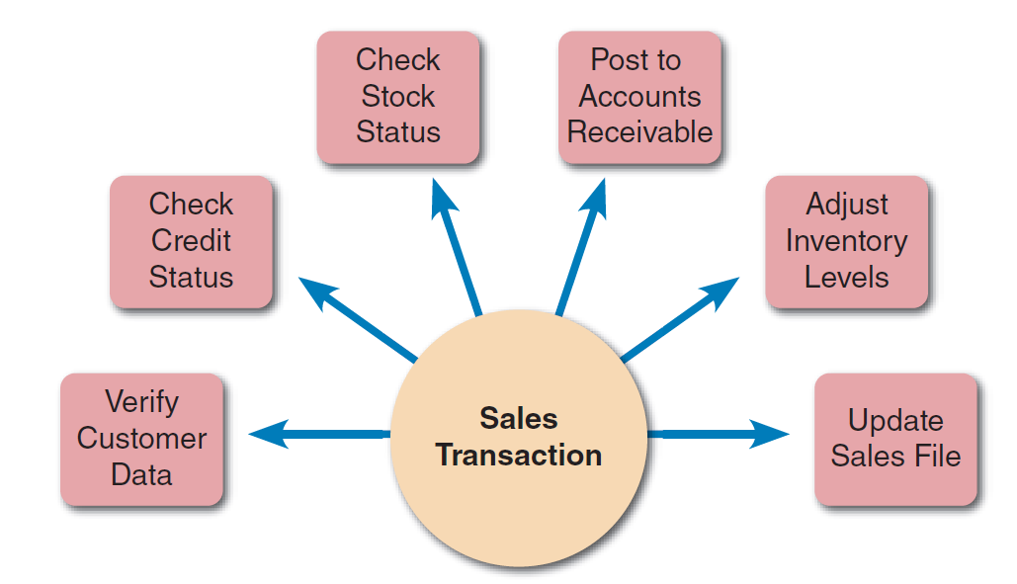
Business Information Systems (Cont.1)
Transaction Processing (TP) Systems
Processes data generated by day-to-day business operations
Examples - Customer order processing, accounts receivable, and warranty claim processing
Business Support Systems
Provide job-related information support to users at all levels of a company
Can work hand-in-hand with a TP system
FIGURE 1-11 A single sales transaction consists of six separate tasks, which the TP system processes as a group.

Slide 17

Business Information Systems (Cont.2)
Management Information Systems (MIS)
Radio frequency identification (RFID)
Uses high-frequency radio waves to track physical objects
Knowledge Management
Uses a knowledge base and inference rules
Knowledge base: Large database that allows users to find information by entering keywords
Inference rules: Identify data patterns and relationships
FIGURE 1-12 With an RFID tag, items can be tracked and monitored throughout the shipping process.
© nullplus/photos.com

Slide 18
Business Information Systems (Cont.3)
User Productivity Systems
Technology that improves productivity
Groupware: Enables data sharing and coordination of efforts
Systems Integration
Combination of transaction processing, business support, knowledge management, and user productivity features

Slide 19
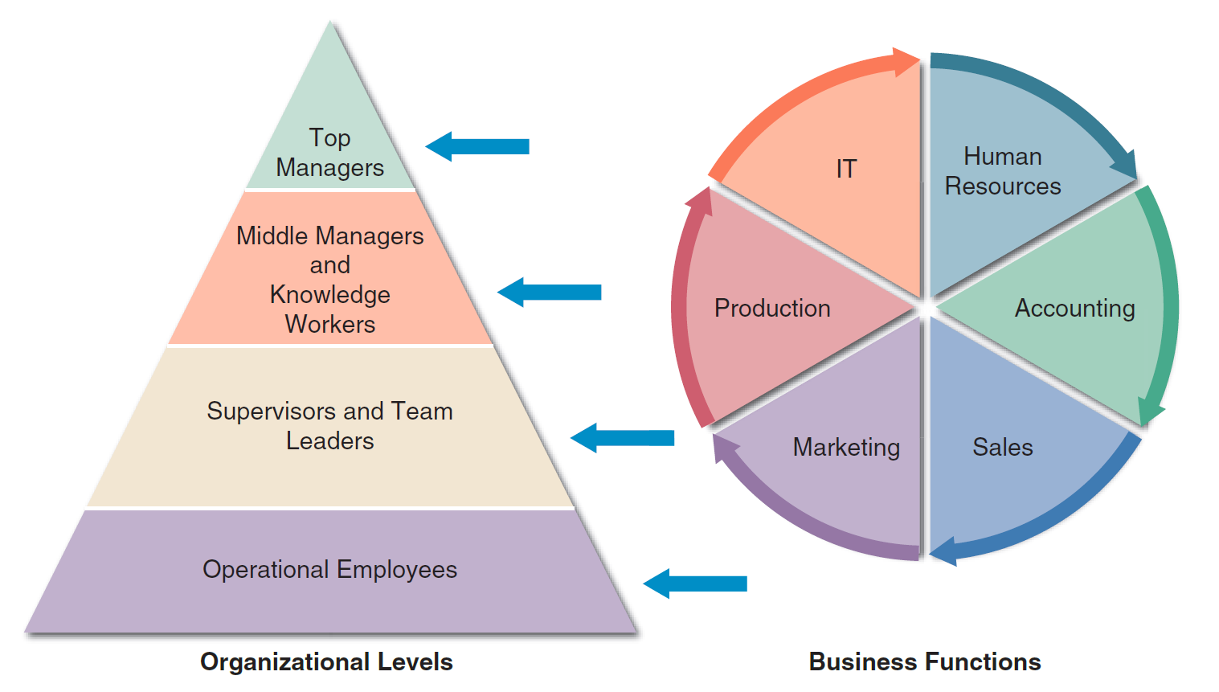
What Information Do Users Need?
FIGURE 1-14 A typical organizational model identifies business functions and organizational levels.

Slide 20
What Information Do Users Need? (Cont.1)
Top Managers
Use IT to develop long-range strategic plans
Require information such as economic forecasts, technology trends, competitive threats, and governmental issues
Middle Managers and Knowledge Workers
Middle managers provide direction, resources, and performance feedback to supervisors and team leaders
Require more detailed information than top managers
Knowledge workers provide support for the organization’s basic functions

Slide 21
What Information Do Users Need? (Cont.2)
Supervisors and Team Leaders
Oversee operational employees and carry out day-to-day functions
Require decision support information, knowledge management systems, and user productivity systems
Operational Employees
Rely on TP systems to enter and receive data they need to perform their jobs
Empowered to handle tasks and make decisions that were assigned previously to supervisors

Slide 22
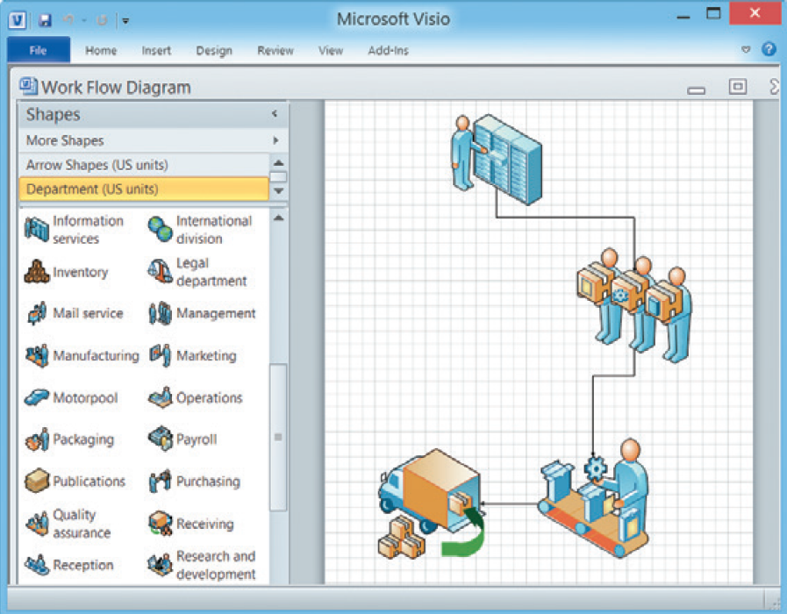
Systems Development Tools
Modeling
Graphical representation of a concept or process
Business model
Data model
Object model
Network model
Process model
FIGURE 1-15 Microsoft Visio allows you to drag and drop various symbols and connect them to show a business process.
Source: Microsoft Visio 2010

Slide 23
Systems Development Tools (Cont.1)
Prototyping
Early working version of an information system
Disadvantage - Important decisions might be made before business or IT issues are thoroughly understood
A prototype based on careful fact-finding and modeling techniques can be an extremely valuable tool

Slide 24
Systems Development Tools (Cont.2)
Computer-Aided Systems Engineering (CASE) Tools
Known as computer-aided software engineering
Provide an overall framework for systems development
Support design methodologies
Structured analysis
Object-oriented analysis
Generate program code
Speeds the implementation process

Slide 25
Systems Development Methods
Structured Analysis
Object-Oriented (O-O) Analysis
Agile/Adaptive Methods

Slide 26
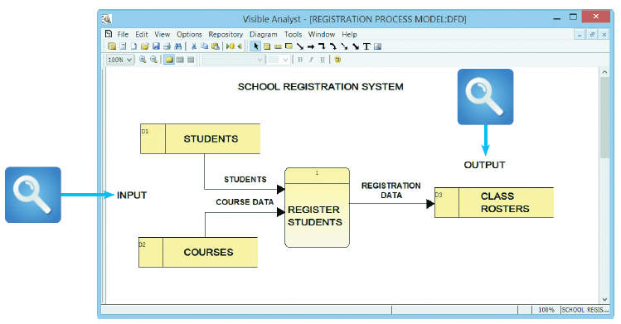
Systems Development Methods (Cont.1)
Structured Analysis
Time-tested and easy to understand
Uses the systems development life cycle (SDLC)
Based on predictive approach
Process-centered technique
Uses process models to graphically describe a system
FIGURE 1-18 This Visible Analyst screen shows a process model for a school registration system. The REGISTER STUDENTS process accepts input data from two sources and transforms it into output data.
Source: Visible Systems Corporation

Slide 27
Systems Development Methods (Cont.2)
Addresses data organization and structure, relational database design, and user interface issues
The SDLC describes activities and functions that all systems developers perform, regardless of which approach they use

Slide 28
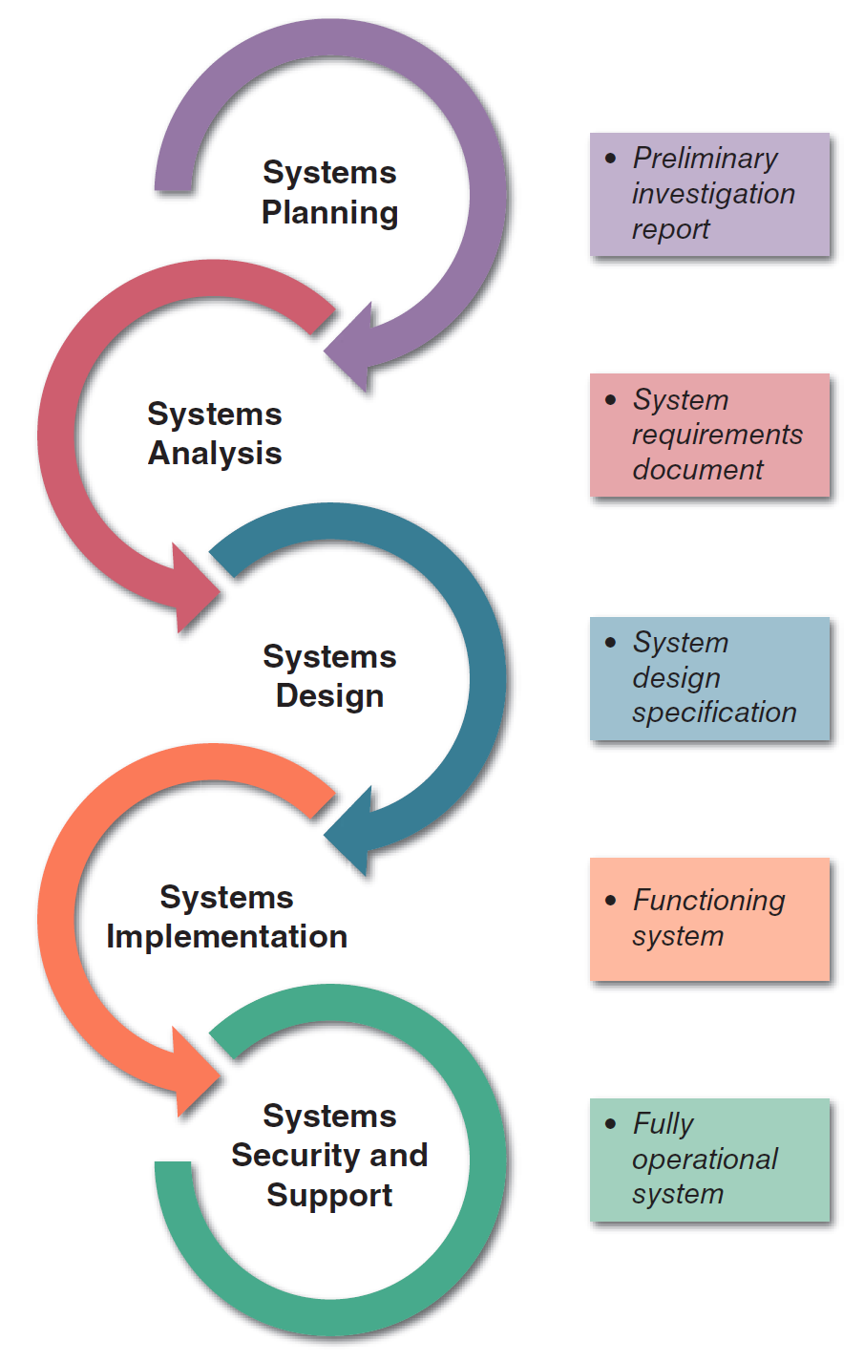
Systems Development Methods (Cont.3)
FIGURE 1-19 Development phases and deliverables are
shown in the waterfall model. The circular symbols indicate
interaction among the phases.

Slide 29
Systems Development Methods (Cont.4)
Steps in the SDLC Model
Systems planning
Initiated by a systems request
Goal - To perform a preliminary investigation
Feasibility study: Reviews anticipated costs and benefits and recommends a course of action
Systems analysis
Goal – To build a logical model of the new system
Requirements modeling: Analyst investigates business processes and documents the functions to be performed by the new system
Deliverable - System requirements document

Slide 30
Systems Development Methods (Cont.5)
Systems design
Goal – To create a physical model that satisfies all documented requirements
User interface is designed and application architecture is determined
Outputs, inputs, and processes are identified
Deliverable - System design specification
Management and user involvement is critical

Slide 31
Systems Development Methods (Cont.6)
Systems implementation
New system is constructed, programs are written, tested, and documented, and the system is installed
Deliverable - A completely functional and documented information system
Includes systems evaluation
Systems support and security
IT staff maintains, enhances, and protects the system
A well-designed system must be secure, reliable, maintainable, and scalable

Slide 32
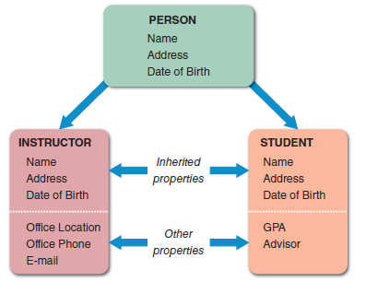
Systems Development Methods (Cont.7)
Object-Oriented Analysis
Combines data and the processes that act on the data into objects
Object: Member of a class, which possesses properties
O-O methodology provides easy transition to O-O programming languages like Java
FIGURE 1-20 The PERSON class includes INSTRUCTOR and STUDENT objects, which have their own properties and inherited
properties.

Slide 33
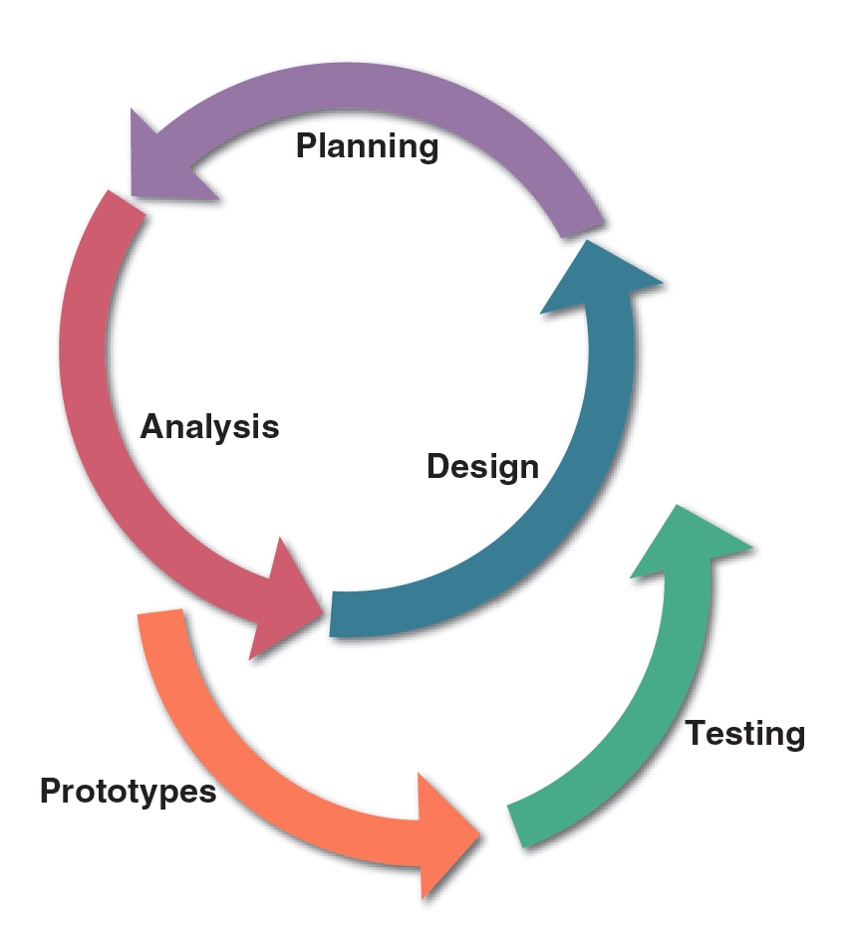
Systems Development Methods (Cont.8)
FIGURE 1-21 In a typical O-O development model, planning, analysis, and design tasks interact continuously to generate prototypes that can be tested.

Slide 34
Systems Development Methods (Cont.9)
Agile Methods
Involve building and constantly adjusting a series of prototypes to user requirements
Use a spiral model
Spiral model: Series of iterations based on user feedback
Feedback from prior steps is incorporated in each incremental step
Allow developers to be more flexible and responsive

Slide 35
Systems Development Methods (Cont.10)
Disadvantages
Riskier than traditional methods
Weak documentation and blurred lines of accountability
Lack of emphasis on the larger business picture
Other Development Methods
Joint application development (JAD)
Focuses on team-based fact-finding
Rapid application development (RAD)
A compressed version of the entire development process

Slide 36
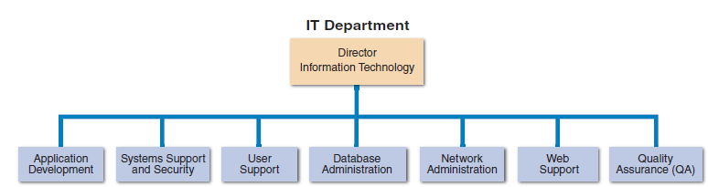
The Information Technology Department
FIGURE 1-23 Depending on its size, an IT department might have separate organizational units for these functions, or they might be combined into a smaller number of teams.

Slide 37
The Information Technology Department (Cont.1)
Application Development
Systems are developed by teams consisting of users, managers, and IT staff members
Systems Support and Security
Provides vital protection and maintenance services
User Support
Provides users with technical information, training, and productivity support
Known as a help desk

Slide 38
The Information Technology Department (Cont.2)
Database Administration
Involves data design, management, security, backup, and access systems
Network Administration
Includes hardware and software maintenance, support, and security
Web Support
Web support specialists design and construct Web pages
Monitor traffic and manage hardware and software
Link Web-based applications information systems to the company’s information systems

Slide 39
The Information Technology Department (Cont.3)
Quality Assurance (QA)
QA team reviews and tests all applications and systems changes to verify specifications and software quality standards

Slide 40
The Systems Analyst
Investigates, analyzes, designs, develops, installs, evaluates, and maintains a company’s information systems
Constantly interacts with users and managers within and outside the organization

Slide 41
The Systems Analyst (Cont.1)
Roles
Acts a translators to managers and programmers
A company’s best line of defense in an IT disaster
Most valuable skill - The ability to listen
Seeks feedback from users to ensure that systems do not deviate from accomplishing set objectives
Knowledge, Skills, and Education
Technical knowledge
Communication and business skills
Critical thinking skills

Slide 42
The Systems Analyst (Cont.2)
Education - A college degree in information systems, science, or business
Some IT experience is required
Certification
Helps IT professionals learn new skills and gain recognition for their efforts

Slide 43
The Systems Analyst (Cont.3)
Career Opportunities
Companies will need systems analysts to apply new information technology
Explosion in e-commerce will fuel IT job growth
Important factors
Job titles
Company organization
Company size
Salary, location and future Growth
Corporate culture

Slide 44
Trends in Information Technology
IT is one of the fastest evolving industries
Knowledge of current trends is vital to a systems analyst
Key trends
Agile methods
Cloud computing
Mobile devices and apps
IT firms now offer a mix of products, services, and support
Social media

Slide 45
Chapter Summary
IT - Combination of hardware and software resources
Used by companies to manage, access, communicate, and share information
Essential components of an information system
Hardware, software, data, processes, and people
Successful companies offer a mix of products, technical and financial services, consulting, and customer support

Slide 46
Chapter Summary (Cont.1)
Types of information systems
Enterprise computing systems, transaction processing systems, business support systems, knowledge management systems, or user productivity systems
Organization structure includes top managers, middle managers and knowledge workers, supervisors and team leaders, and operational employees

Slide 47
Chapter Summary (Cont.2)
Systems analysts use modelling, prototyping, and computer-aided systems engineering (CASE) tools
Popular system development approaches
Structured analysis, object-oriented analysis, and agile methods
In addition to technical knowledge, a systems analyst must understand the business, think critically, and communicate effectively

